Slide 1
Bay Area Car Rentals
Presenter: Shuye Tang & MingQing Zhu

Slide 2
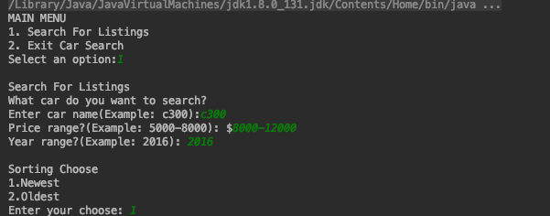
Main Function:
1. Scrape the data by using Craigslist API
2. Save the results into a local txt file
Main menu pops out. Have choice of searching or existing.
Enter the car brand or model, price range and year for searching.
Choose way to show the result by newest or oldest.

Slide 3
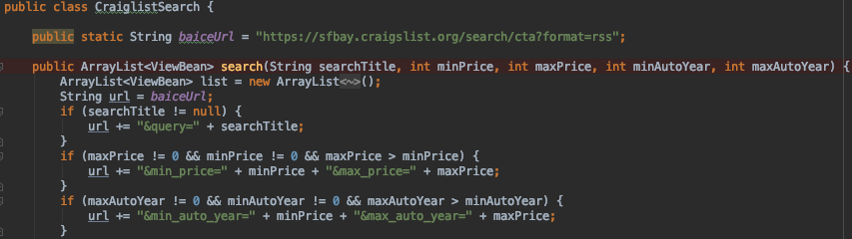
Web Scraping
Using ROME framework to read and get data from RSS (Really Simple Syndication) webpage
Get the RSS url of the specific type of car that user wants to search

Slide 4
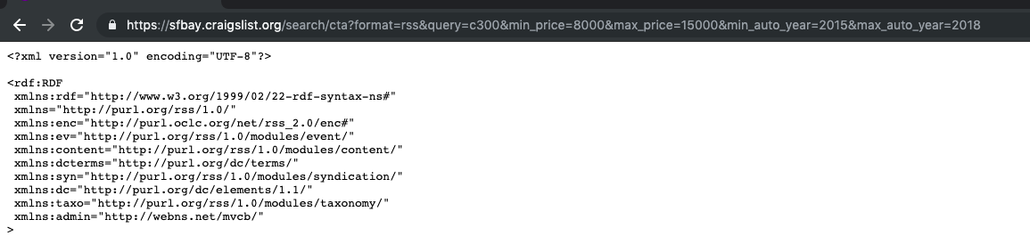
Web Scraping
Get the RSS url of the specific type of car that user wants to search

Slide 5
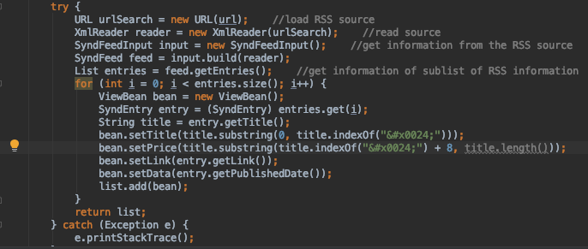
Web Scraping
Parse data from the RSS url and put these data into a list
Put the data we just read into a list

Slide 6
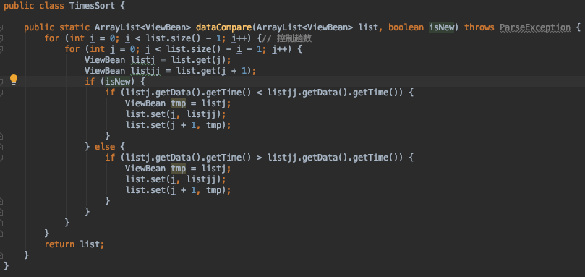
Sorting data
Using bubble sort to sort the list

Slide 7
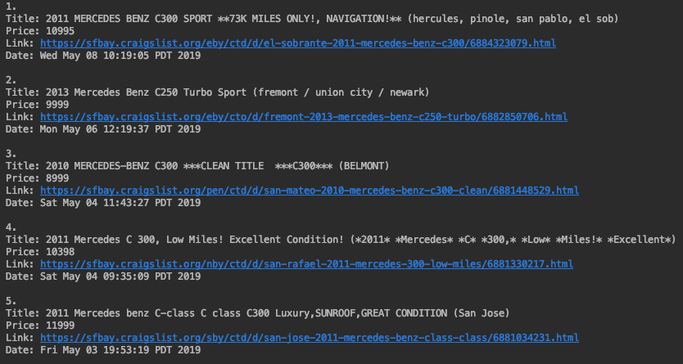
Outcome

Slide 8
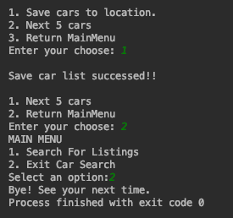
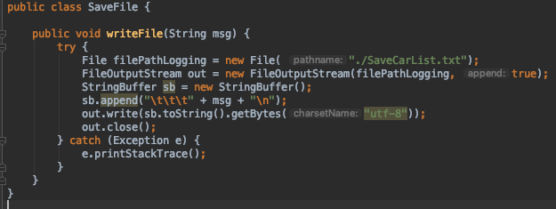
Outcome
Using StringBuffer to hold the data
and use FileOutputStream to write them into a txt file

Slide 9
Things to improve
Organize the data saved in the local txt file to make it more readable.
2. User can choose a specific result they like to save into local txt file.
3. Adding a compare function which can make a compare between two saved results.
4. GUI

Slide 10
Thank you!

